Slide 1

Phishing Awareness Training
Protect yourself from increasingly sophisticated online threats targeting your sensitive information.
Learn to identify and avoid phishing attempts that could compromise your personal and professional security.
SURIYA HOQUE SHETHILA

Slide 2

What is Phishing?
Deceptive Tactic
Criminal Objective
Cyber-attacks that impersonate legitimate entities through fake communications.
Theft of sensitive information including passwords, financial data, and personal details.
Massive Scale
Over 3.4 billion phishing emails are sent daily worldwide.

Slide 3
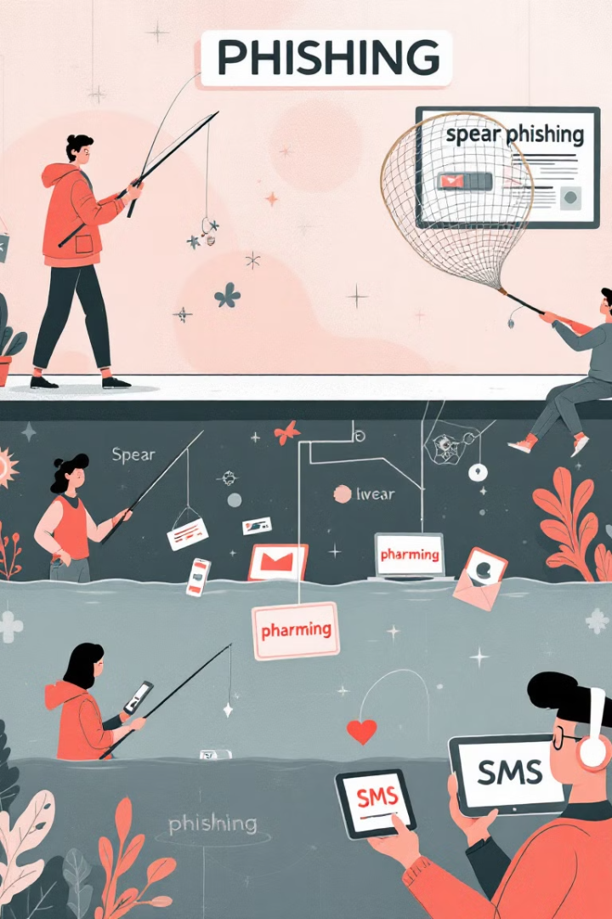




Common Phishing Techniques
Email Phishing
Fake emails masquerading as trusted sources to extract sensitive information.
Spear Phishing
Highly targeted attacks focusing on specific individuals with personalized content.
Vishing (Voice Phishing)
Phone-based scams using social engineering to extract information.
Smishing
SMS-based phishing attacks delivering malicious links through text messages.

Slide 4
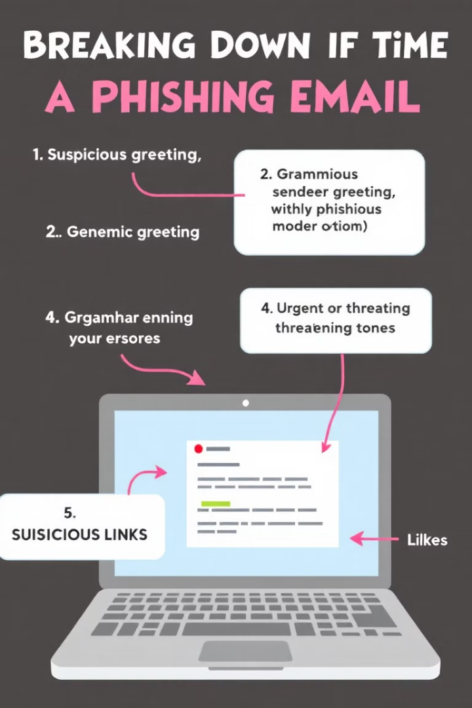




Anatomy of a Phishing Email
Urgent Language
Creates pressure to act quickly without thinking critically.
Suspicious Sender
Email addresses with slight misspellings or unusual domains.
Generic Greetings
"Dear Customer" instead of your actual name.
Requests for Data
Asking for sensitive information through email or links.

Slide 5
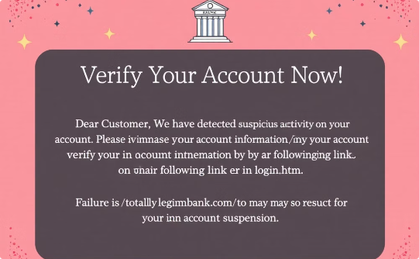
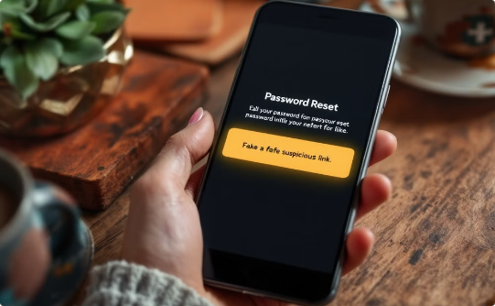
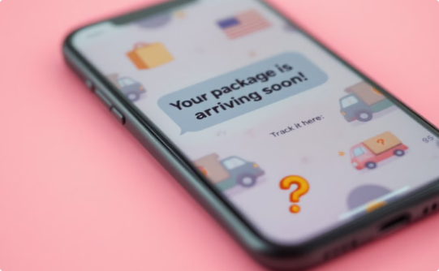
Real-World Phishing Examples
Bank Account Scams
Social Media Tricks
Delivery Notifications
Emails claiming account issues requiring immediate verification of credentials.
Fraudulent password reset notifications with malicious links.
Fake delivery alerts requiring personal information to "claim" packages.

Slide 6








How to Protect Yourself
Verify Sources
Confirm sender identities through official channels
Exercise Caution
Avoid suspicious links and unexpected attachments
Use MFA
Enable multi-factor authentication on accounts
Update Systems
Keep software and security patches current

Slide 7

What to Do If You're Phished
Reset Passwords
Change compromised credentials immediately across all accounts.
Report the Incident
Alert your IT department or security team without delay.
Monitor Accounts
Watch for unusual activity or unauthorized transactions.
Contact Authorities
Report to relevant agencies like the FBI's Internet Crime Complaint Center.

Slide 8








Key Takeaways
Verify Independently
Continuous Education
Confirm suspicious requests through official channels.
Keep learning about emerging phishing tactics.
Stay Vigilant
Trust Your Instincts
Approach unexpected messages with healthy skepticism.
Legitimate organizations never request sensitive information via email.

